Slide 1
Generation Z - A Look at their Technology and Media Habits and Implementing Best Practices
Michael England, M.A., M.Ed., Ed.D.
Southwestern Adventist University

Slide 3
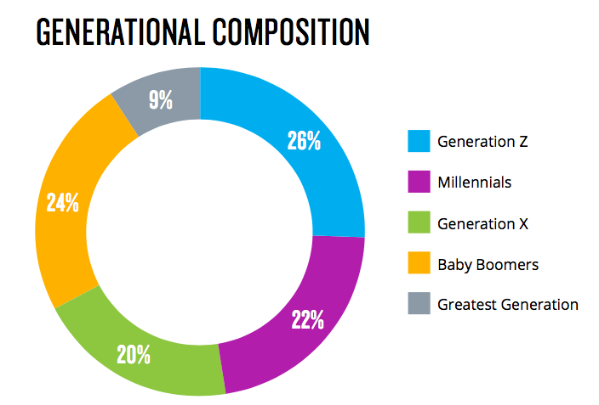

Slide 4
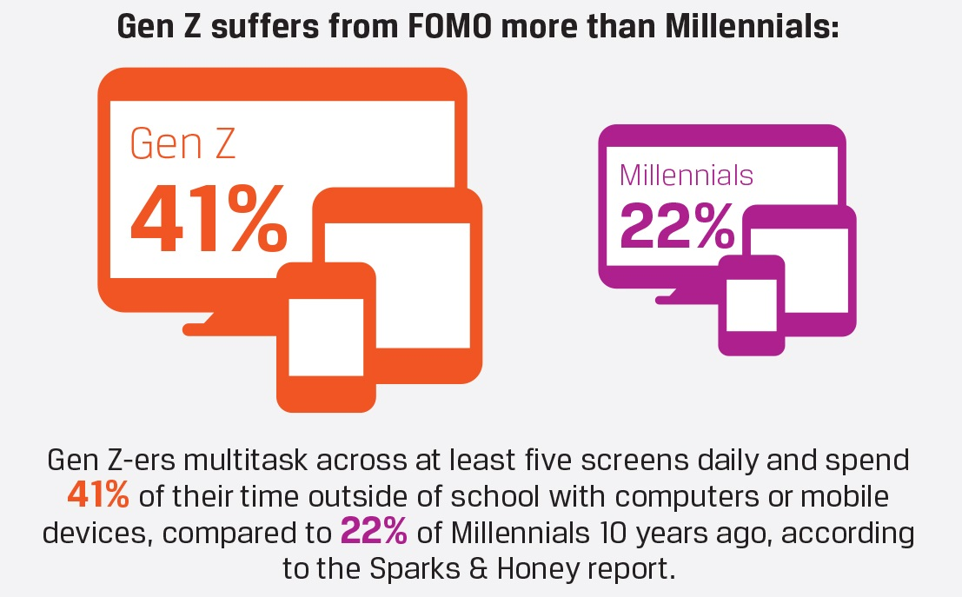

Slide 6
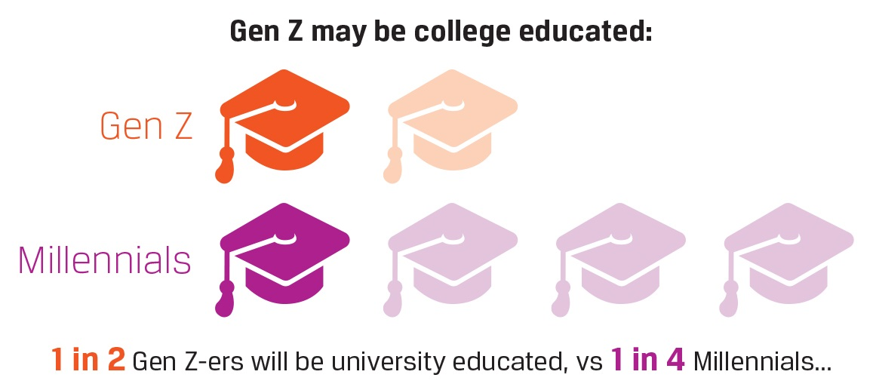

Slide 7
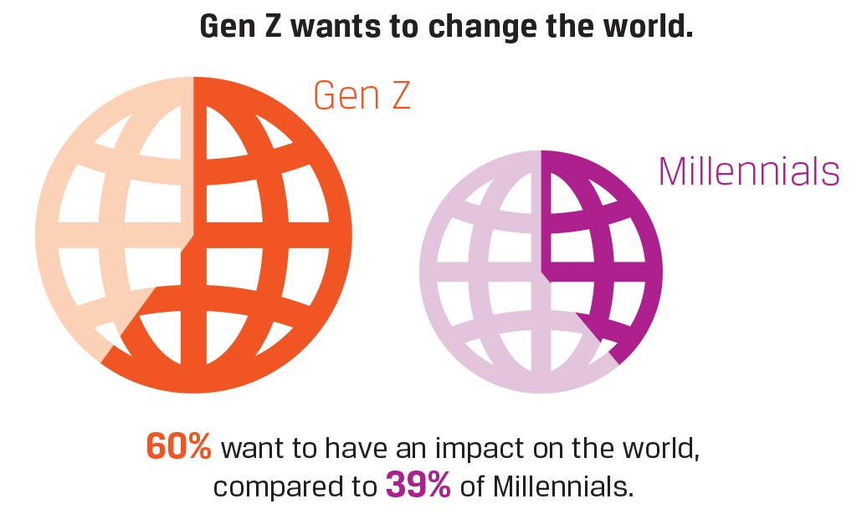

Slide 8
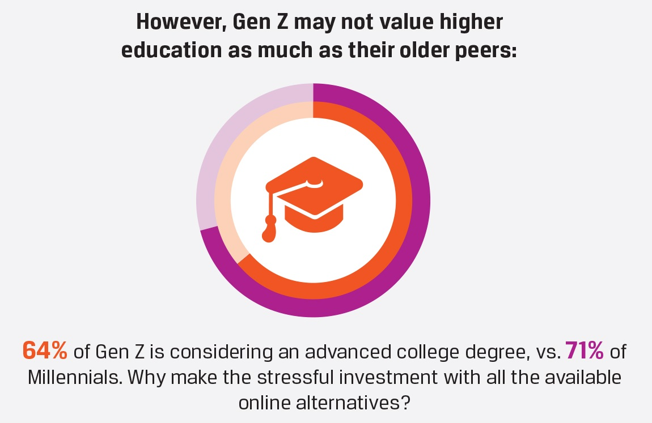

Slide 9
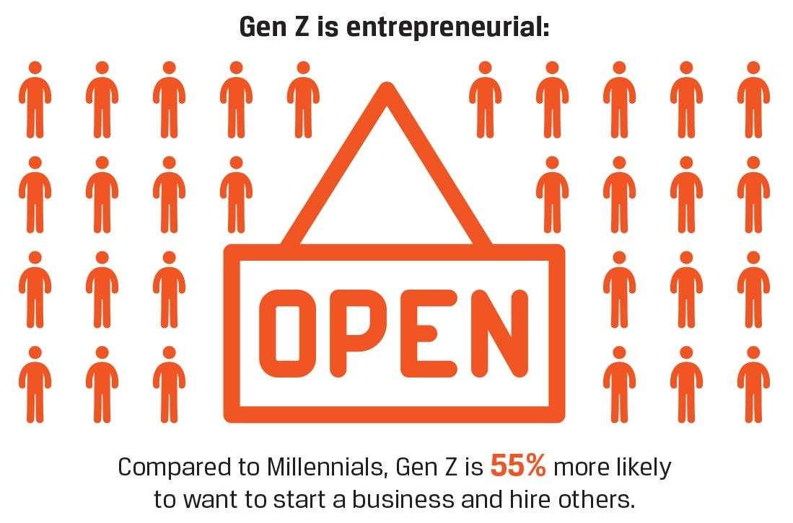

Slide 10
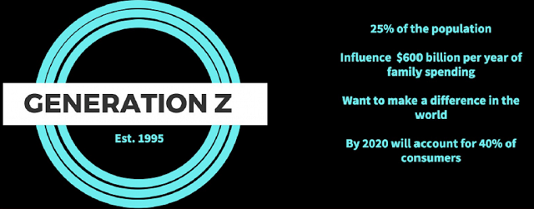

Slide 11
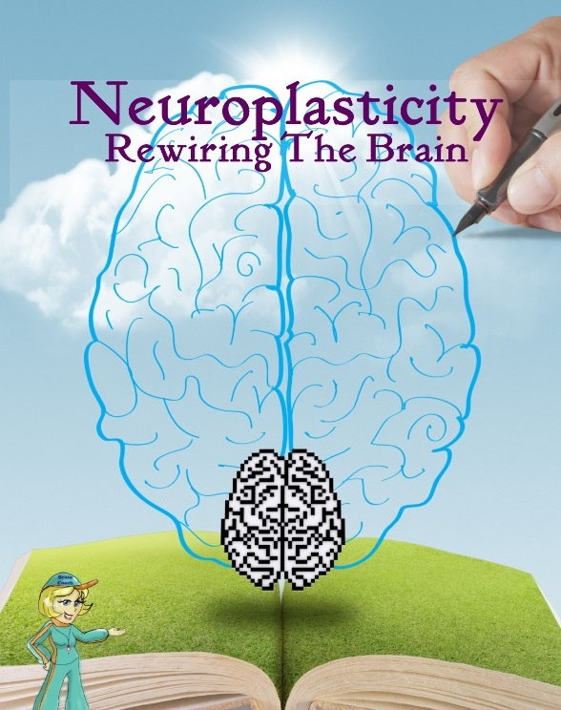
People are becoming accustomed to a constant stream of digital stimulation and feel bored in the absence of it. “Regardless of whether the stimulation is from the Internet, TV or a cellphone, the brain, is hijacked.”
The internet is rewiring our brains, making us think more superficially at the expense of deep reading and analysis. With such heavy use of internet media already, are children's brains more vulnerable to these pressures, or will Generation Z deal more intuitively with these demands?

Slide 12
Generation Z is impatient and requiring instant gratification, an introverted and aloof generation, with a lower attention span.
Such a high dependence on technology has led to some psychologists suggesting that there is evidence of ‘Acquired Attention Deficit Disorder.’ Dr. Edward Hallowell, Psychiatrist, former Harvard Medical School faculty member and a specialist in attention deficit disorder claims people have “...become so busy attending to so many inputs and outputs that you become increasingly distracted, irritable, impulsive, restless and, over the long term, underachieving...You live at a much more surface level.”

Slide 13
"If our attention span constricts to the point where we can only take information in 140-character sentences, then then that doesn't bode too well for our future," said Dr. Elias Aboujaoude, director of Stanford University's Impulse Control Disorders Clinic at Stanford University. "The more we become used to just sound bites and tweets," Aboujaoude said, “the less patient we will be with more complex, more meaningful information. And I do think we might lose the ability to analyze things with any depth and nuance. Like any skill, if you don't use it, you lose it.” https://goo.gl/H54cEi

Slide 14
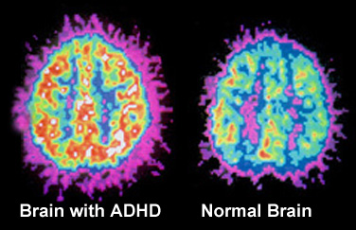
One reason that ADD is on the rise is that our attention span is similar to our attention span on Facebook. Look at language. People are writing the way that they text. Anything complex that takes several paragraphs to develop is information overload at this point.

Slide 15
Gen Z brains have become wired to sophisticated, complex visual imagery. Audio and kinesthetic learning is out. So is talk – or lecturing as Gen Z sees it. They’re avid gamers, they’ll spend 30,000 hours gaming by the age of 20. They want learning to be the same—a sequence of challenges with instant feedback on progress, clear goals and rewards linked to them. Their gaming profile is shown at the end of the challenge which displays their overall accomplishments—e-Learning profiles are what they demand. You want to engage Gen Z? Turn lessons into video games!

Slide 16
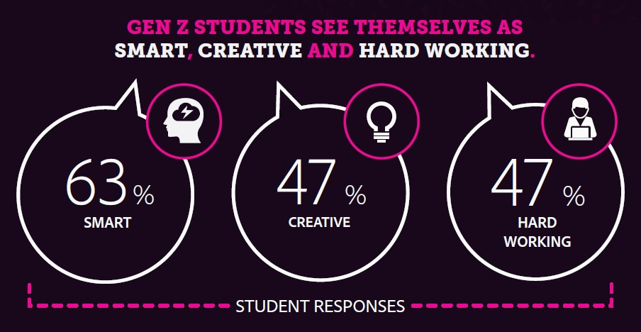
Adobe Educate asked 2,500+ Gen Z students aged 11-17, and 1,000+ Gen Z teachers to tell us how they feel about learning, creativity and the future, and here is what they found...

Slide 18
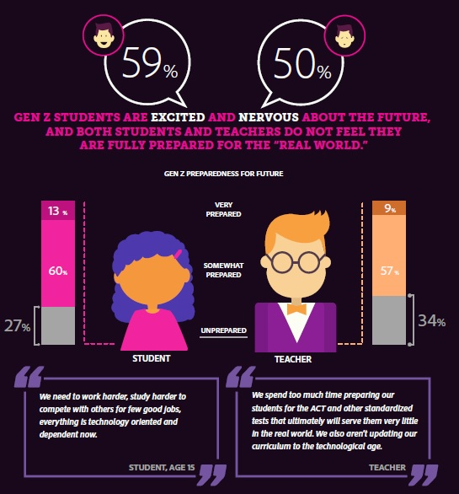

Slide 19
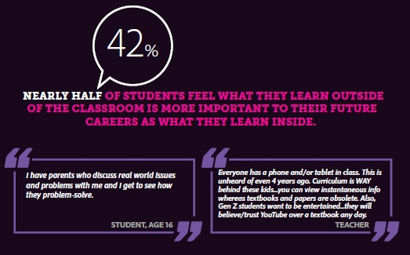

Slide 20
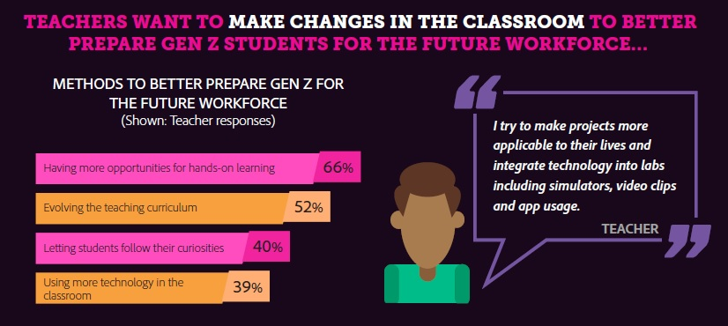

Slide 21
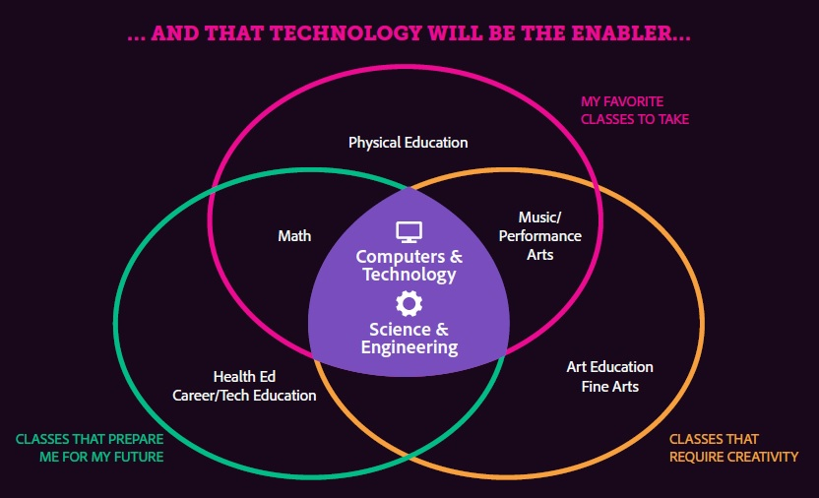

Slide 22
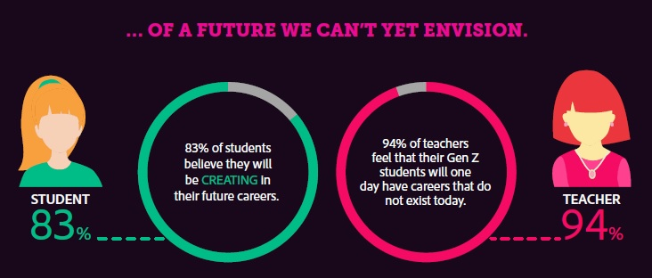

Slide 25
GEN Z Learner Mindset
Old school teachers tend to not appreciate Gen Z’s digital skills or how their brains are wired.
Access to so much data makes Gen Z’s go for the quick answer rather than longer problem solving.
Gen Z’s often do not take the time to determine the reliability of information.

Slide 26
GEN Z Learner Mindset
Gen Z’s are driven by graphics in learning. They comprehend complex graphics better than previous generations.
Gen Z’s become incredibly more knowledgeable about their passions than the generations before them because they have access to so much more information, and they can network with peers across the globe who have the same interests.
They must be taught to discover, curate, and manage information. This will be essential in the “idea economy” of the knowledge era.

Slide 27
GEN Z Learner Mindset
Gen Z students need to be challenged with project-based, active learning to meet the demands of the future.
The like to have random access to information, love to explore using their own routes, need graphics, want it fun, and instant feedback.
The Gen Z world is increasing collaborative, and their school projects need to reflect that.

Slide 28
THEME #1—Provide Small Bits of Information at a Time.
Students read less than 20% of text and only spend 4.4 seconds for every 100 words on the page, which is obvious that the traditional reading assignments are not going to engage them.

Slide 29
THEME #2—Tap into Your “Rock Star” Qualities.
Successful faculty, like rock stars, have the natural ability to incite students’ passion, captivate their attention, and intrigue their minds. A rock star “seamlessly exploits the affordances of digital tools, weaving them into their highly interactive and unpredictable performances.”

Slide 30
THEME #3—Surrender the Soapbox.
One of the ways that Gen Z’s learn best is through “chunking” of information as opposed to a long-drawn out lecture. They prefer to engage with a community of learners of shared interests using interactive multimedia.

Slide 31
THEME #4—Meddle in the Middle.
shift their mindset and role of “sage-on-the-stage” to “meddler-in-the-middle.” In the meddler-in-the-middle teaching approach, the faculty is learning and doing, making mistakes, and engaging in trial and error, alongside students.

Slide 32
THEME #5—Revalue the Notion of “Play.”
Play is the “dominant way of knowing, doing and creating value in the 21st century.” Higher education institutions and faculty will need to “play,” and create educational social environments where students can once again be curious, energetic, creative, dynamic, synergistic, imaginative and fearless in the face of an unpredictable, competitive, fast-paced, technologically-demanding, emergent world.

Slide 33
GEN Z Learner – Summary
Fast delivery of content, data, and graphics.
Kinesthetic, experiential, problem-solving, hands-on activities.
Speed, convenience, and finding short cuts to obtaining information.
Integration of interactive multimedia.
Multi-tasking.
Instant feedback, clear goals, challenges, rewards, and positive reinforcement, as found in video games.
Delivery of learning in small “bites” or little chunks.
Trial and error approach.
Problem solving assignments and exercises instead of memorizing.
Working in teams/small groups.
Engagement in creativity and collaboration, whether it is spontaneous
Flexibility to learn in the way that works best for them.
Rothman Ph.D., D. A tsunami of learners called generation Z. Retrieved from
http://mdle.net/Journal/A_Tsunami_of_Learners_Called_Generation_Z.pdf

Slide 34
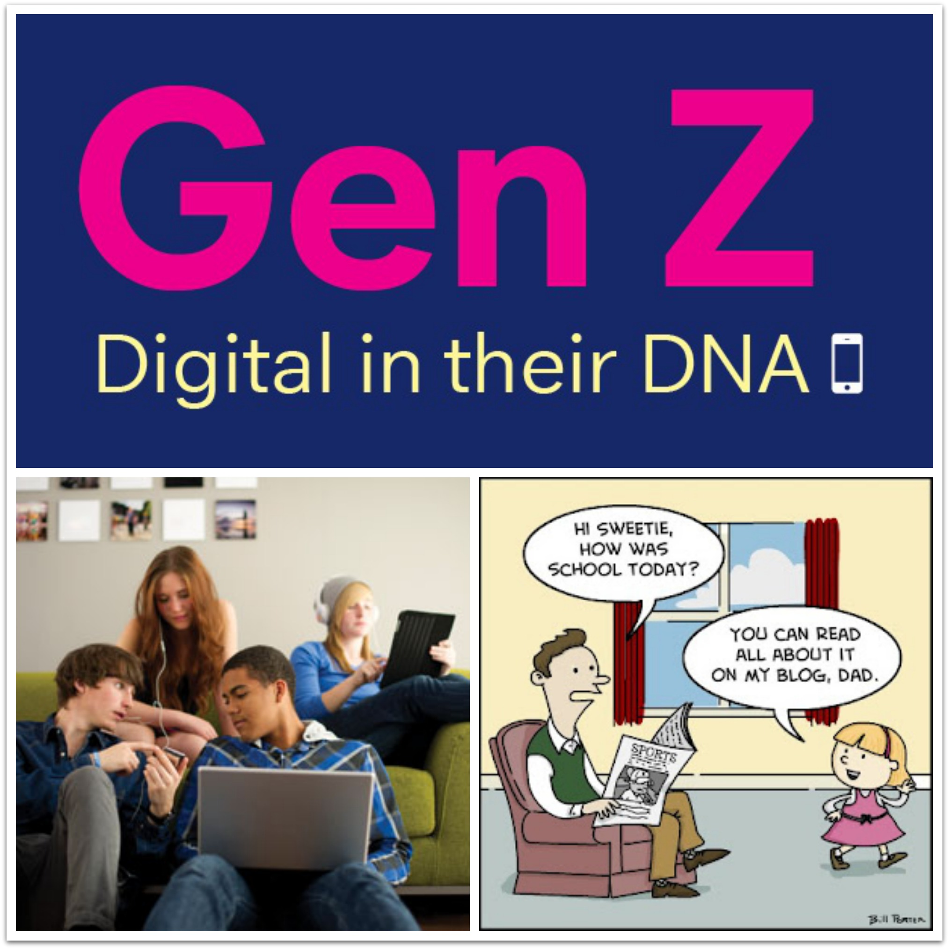

Slide 35
Meet Generation Alpha
Born 2010 ➔
Get presentation, detailed report,
Video links, and websites.
➔
https://goo.gl/zCZqLe

